Slide 1

Introduction to Machine Learning

Slide 2
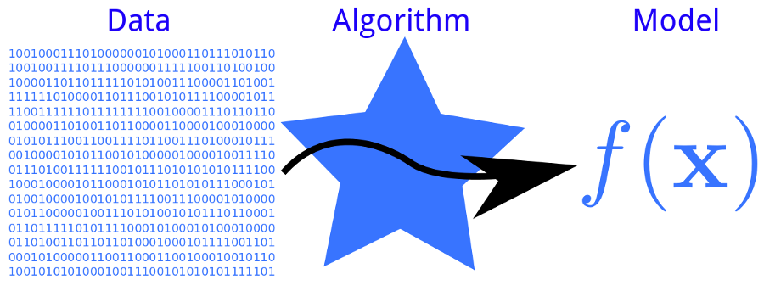
What is Machine Learning
Learn from Experience E (Data) with respect to some class of tasks T (our analysis target) and performance measure P (Validation Measure to test accuracy), to see if the performance at tasks in T measured by P can improve with experience E.
Notes:
Y variable – descrete

Slide 3
General Learning Models - Supervised
“Labeled” data
Feature Vector + Labels =
Predictive Model
Two Categories:
Regression
Classification
Notes:
Y variable – descrete

Slide 4
Supervised Learning Categories
Classification: Identifying to which of a set of categories a new observation belongs, on the basis of a training set of data containing observations whose category membership is known.
Regression: assuming the target values come from a sort of function and focused on finding the relationship between input variables and the continuous outputs.
Notes:
Y variable – descrete

Slide 5
General Learning Models - Unsupervised
Unlabeled Data
Feature Vectors + Intrinsic structure =
Predicted Clusters

Slide 6
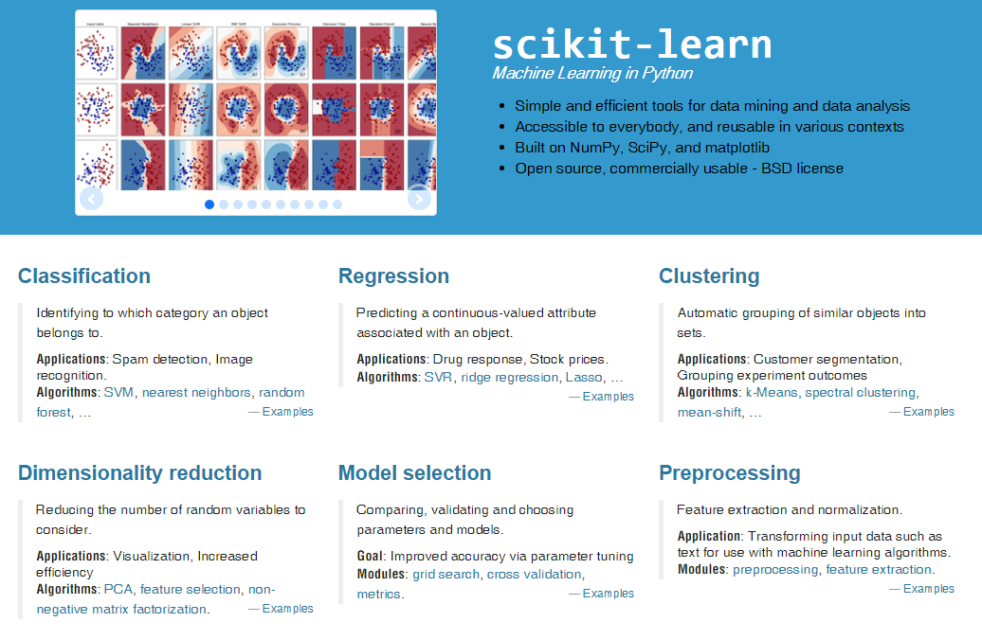
Scikit-Learn: Machine Learning in Python
Scikit-Learn Official Document: http://scikit-learn.org/stable/
A Free Online Book on ML: http://robotics.stanford.edu/people/nilsson/MLBOOK.pdf
Andrew Ng's Machine Learning Class: https://www.coursera.org/learn/machine-learning

